Slide 1
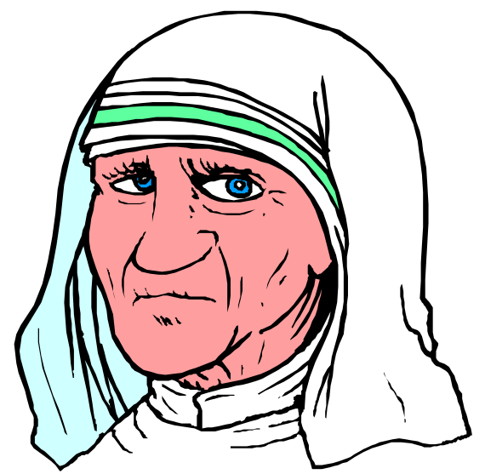
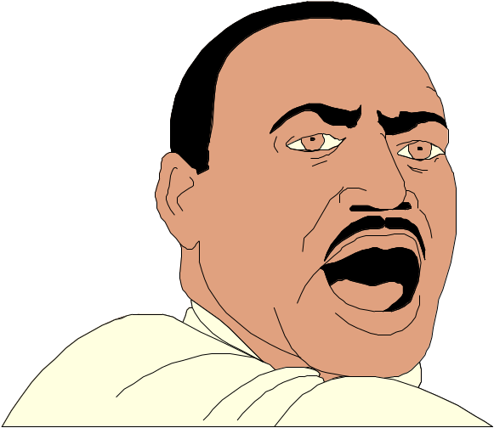
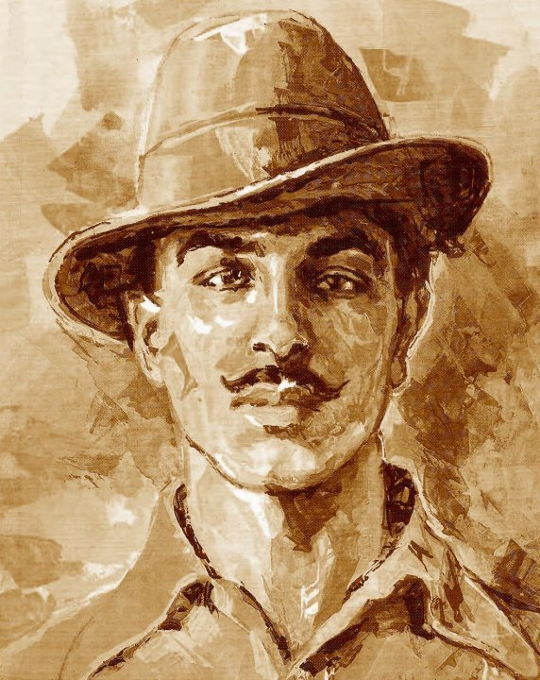
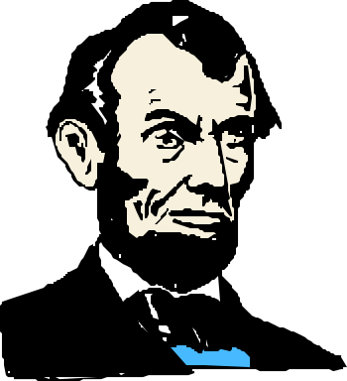
Leadership

Slide 2
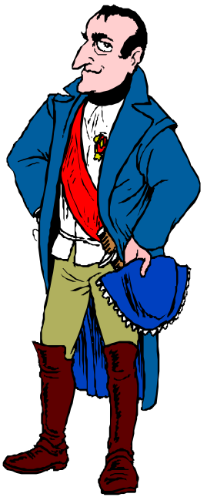
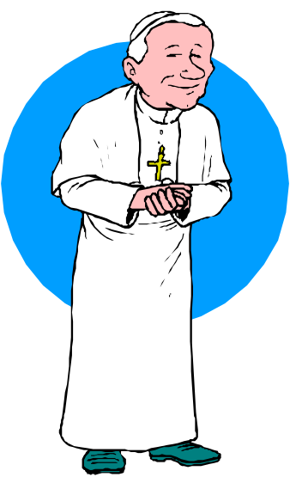
What is leadership?
Leading people
Influencing people
Commanding people
Guiding people

Slide 3
….
Leaders are people who can influence the behaviors of others without depending on force or people whom others accept as leaders.

Slide 4
Types of Leaders
Leader by the position achieved
Leader by personality, charisma
Leader by moral example
Leader by power held
Intellectual leader
Leader because of ability to accomplish things

Slide 5
Leadership and Management
Leadership and management are related, but they are not the same.
Organizations need both leadership and management if they are to be effective.
Leadership is necessary to create change; management is necessary to achieve orderly results.

Slide 6
Managers vs. Leaders
Managers
Focus on things
Do things right
Plan
Organize
Direct
Control
Follows the rules
Leaders
Focus on people
Do the right things
Inspire
Influence
Motivate
Build
Shape entities

Slide 7

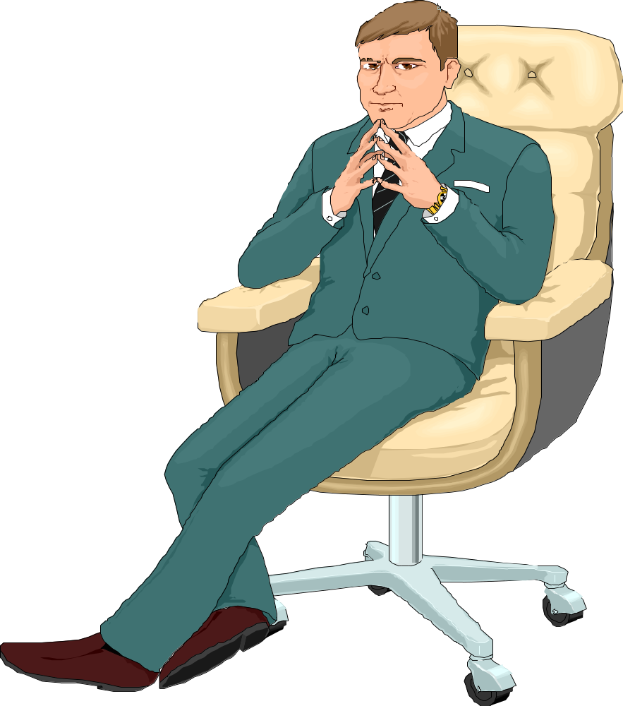
Common Activities
Planning
Organizing
Directing
Controlling

Slide 8

Planning
Leader
Devises strategy
Sets direction
Creates vision
Manager
Planning
Budgeting
Sets targets
Establishes detailed steps
Allocates resources

Slide 9
Organizing
Manager
Creates structure
Job descriptions
Staffing
Hierarchy
Delegates
Training
Leader
Gets people on board for strategy
Communication
Networks

Slide 10

Directing Work
Manager
Solves problems
Negotiates
Brings to consensus
Leader
Empowers people
Cheer or motivate

Slide 11
Controlling
Manager
Implements control systems
Performance measures
Identifies variances
Fixes variances
Leader
Motivate
Inspire
Gives sense of accomplishment

Slide 12
Leadership Traits
Intelligence
  More intelligent than non-leaders
  Scholar
  Knowledge
  Being able to get things done
Physical
  Appearance
Personality
  Verbal facility
  Honesty
  Initiative
  Aggressive
  Self-confident
  Ambitious
  Originality
  Sociability
  Adaptability

Slide 13

How Far Can You Go?

